Slide 1

Kentucky’s 2024-2030 Highway Plan
Jason J. Siwula, PE
Deputy State Highway Engineer
Project Development

Slide 2
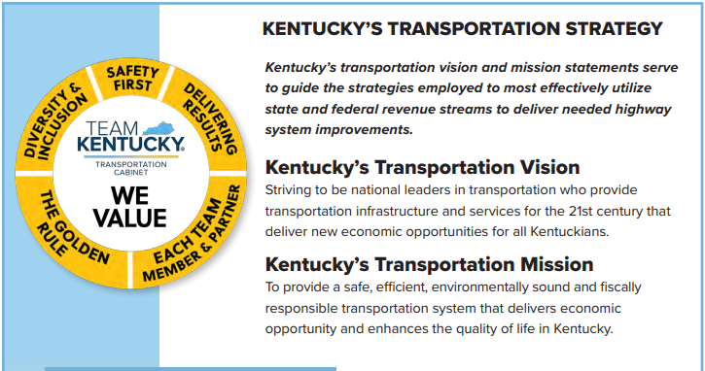

Slide 3
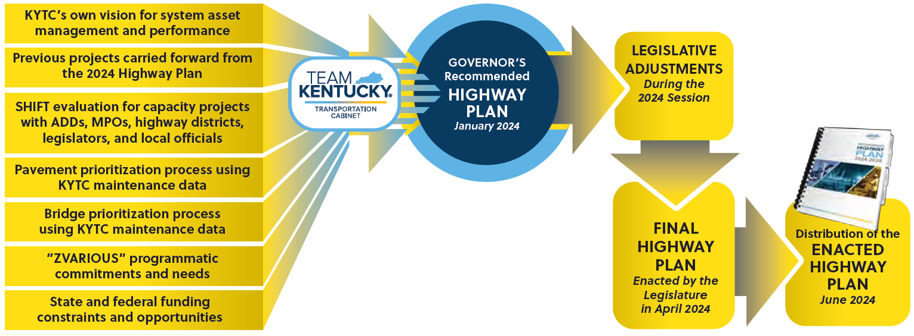
Factors Affecting the 2024 Recommended Highway Plan

Slide 4
2024 Recommended Highway Plan
Three Key Areas
Maintaining existing roads and bridges
Advancing Capital Projects to Construction
Fulfilling past commitments while advancing ongoing initiatives

Slide 5
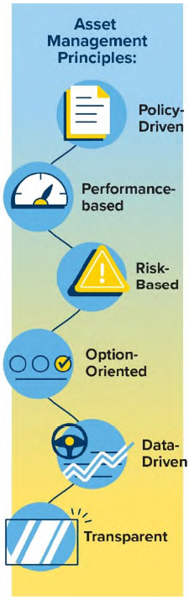
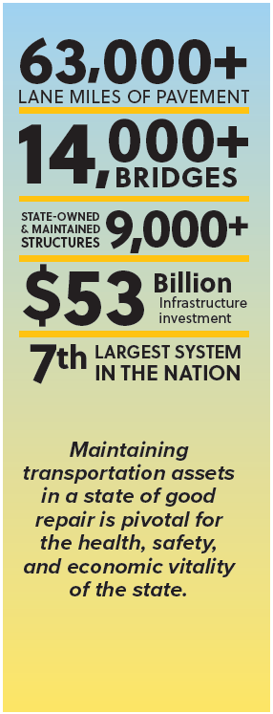
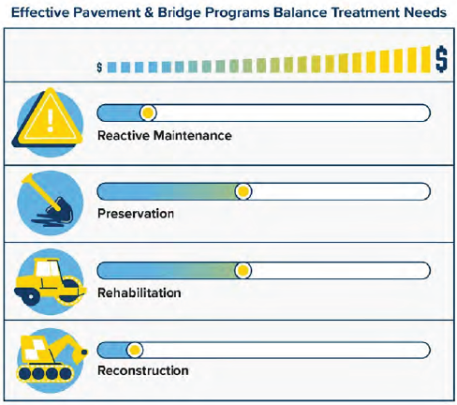

Slide 6
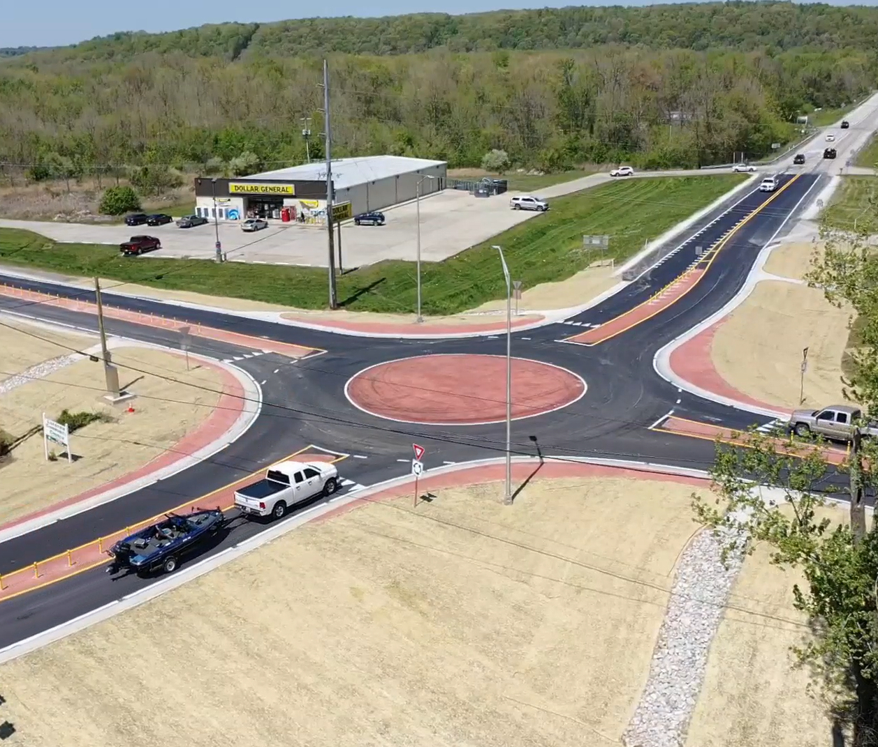

Capacity Improvement Project Factors

Slide 7
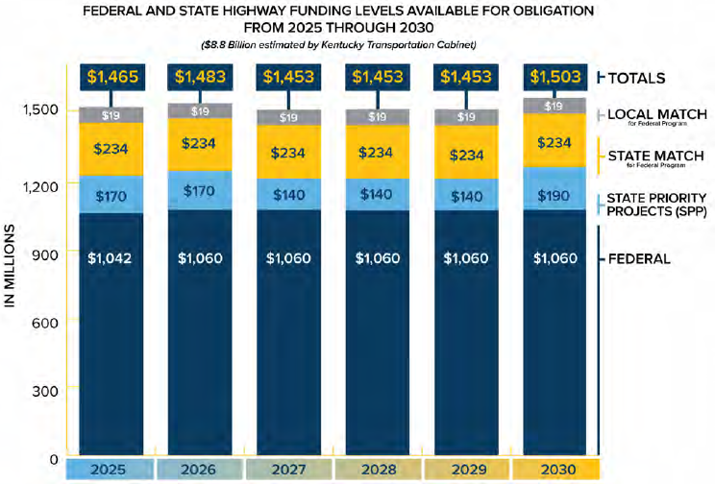
Anticipated Funding Levels 2025-2030

Slide 8
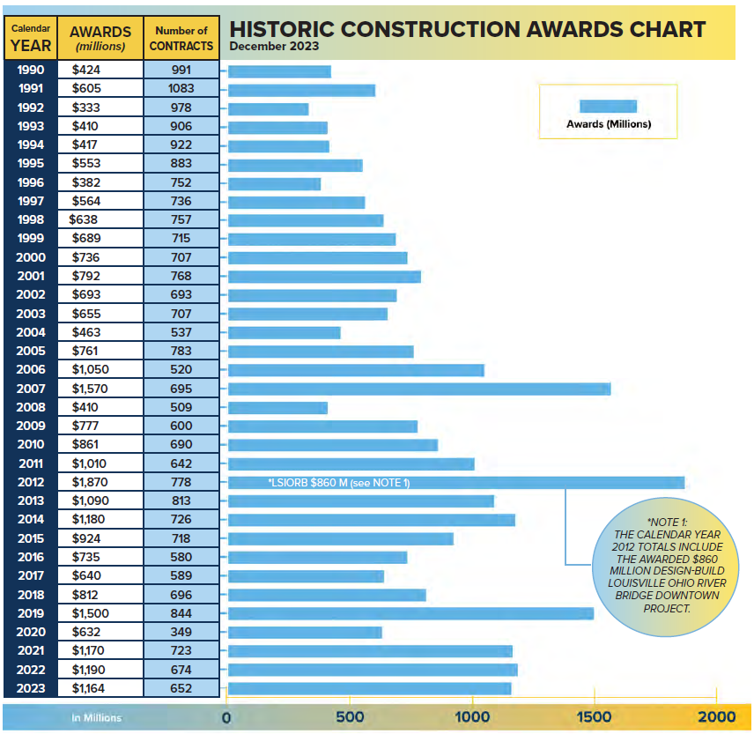

Slide 9
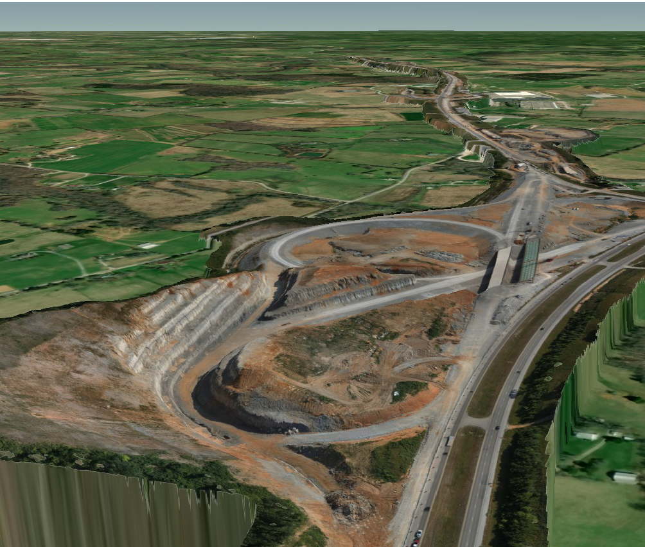
Robust Federal Grant Programs
  INFRA
  RAISE
  Bridge Investment
  MEGA
  PROTECT
  RURAL
  Safe Streets for All
  EV Charging

Slide 10

Kentucky Mega Projects

Slide 11


CONTACT INFORMATION
Jason J. Siwula, PE
Deputy State Highway Engineer
Kentucky Transportation Cabinet
Jason.siwula@ky.gov
@KYTC
@kytc120

